Slide 1
Quadcopters

Slide 2
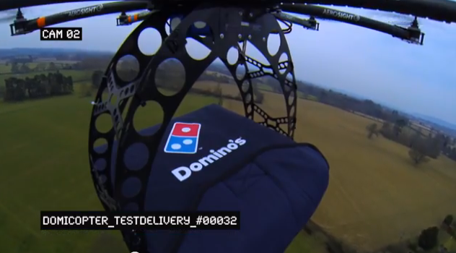
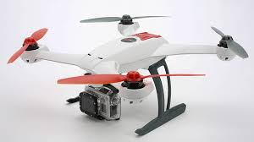
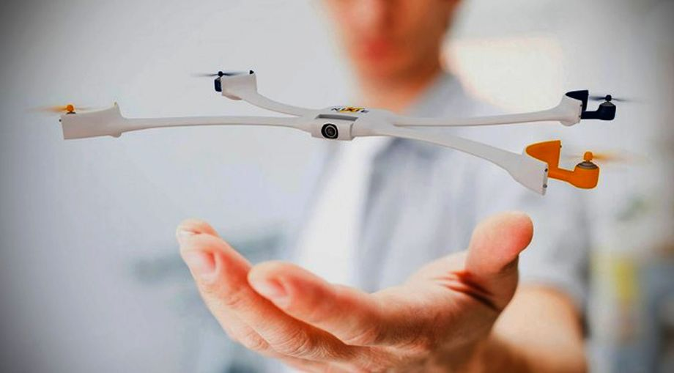
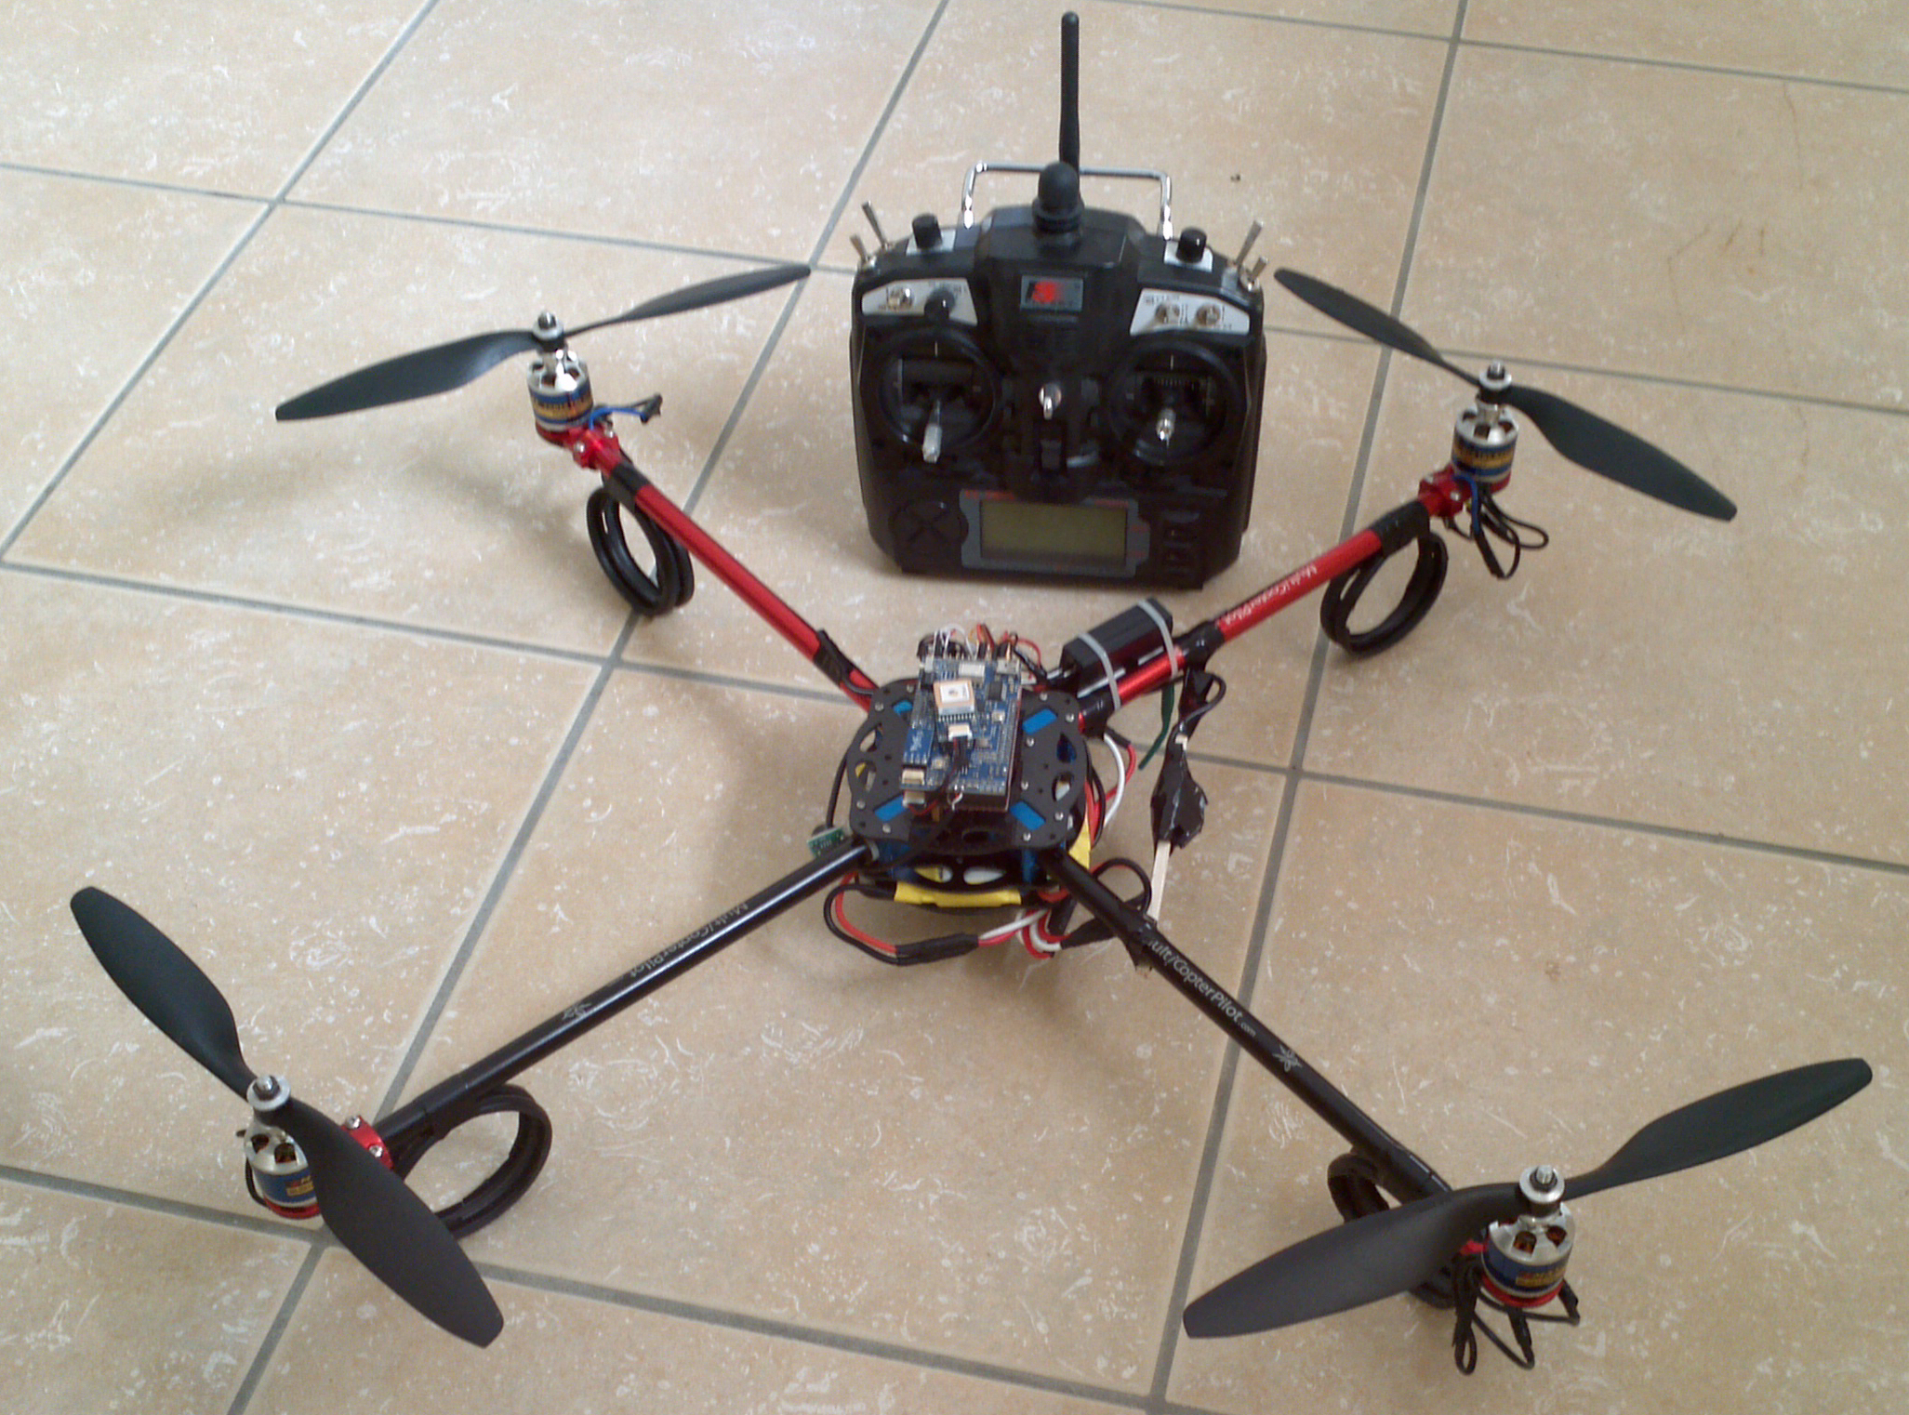
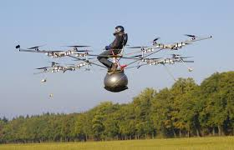
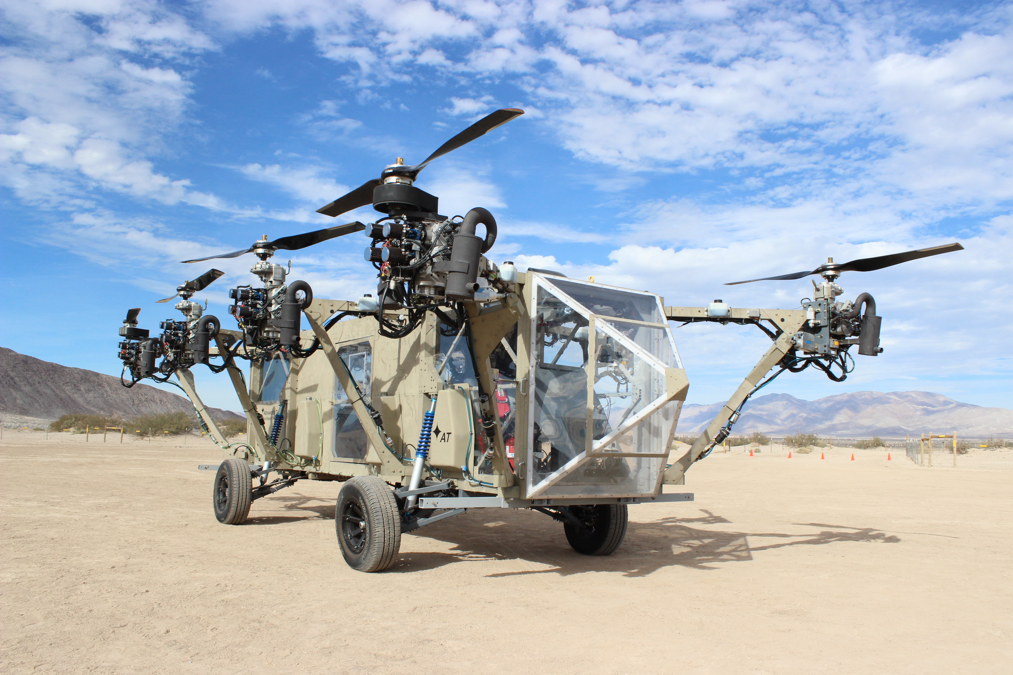
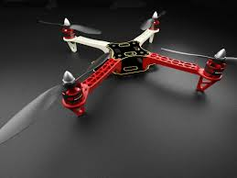
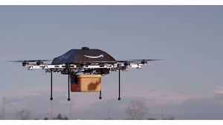
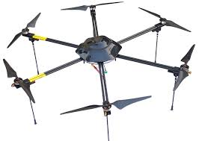

Slide 3
Multirotor Aircraft Components
Airframe
Structural support
Plastic, aluminum, wood, or PCB (fiberglass)
Motors
Lift, movement, and control
Brushed DC motors for small craft
Brushless brushless DC motors for large craft.
Inertial Measurement Unit (IMU)
Sensing the aircraft’s orientation and movement
Gyroscopes and accelerometers.
Computing resources (microcontroller/processor)
To run the flight control software
Manage communication
Flight control software
Provides stability using the IMU and motors
Converts pilot commands to motor outputs
Radio
For receiving command
Returning telemetry.
Power supply
Lots of power for the motors
Carefully regulated power for the IMU and micro controller.

Slide 4
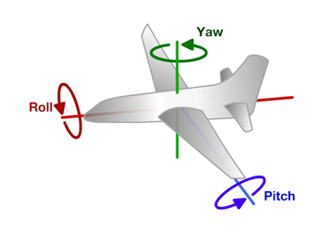
Principles of Operation (1)
An even number of motors provides lift and control in 6 dimensions
Spatial dimensions: x, y, z
Pitch: rotation around left-right (y) axis
Roll: rotation around the front-back (x) axis
Yaw: rotation around the top-bottom (z) axis
A flight computer operates a closed-loop controller to maintain stability and implement pilot commands.
Z
X
Y

Slide 5
Controlling Pitch
Pitch forward
More thrust to the rear
Less to the front
Pitch backward
Less thrust to the rear
More to the back

Slide 6
Controlling Roll
Pitch Left
More thrust to the right motor
Less to the left
Pitch Right
More thrust to the left motor
Less to the Right

Slide 7
Controlling Yaw
Rotate CCW
More thrust to the CCW motors
Less to the CW
Rotate CW
More thrust CW motors
Less to the CCW

Slide 8
Some Possible Configurations
Hexa +
Hexa x
“Plus”
“X”
Octa +
Octa x
“Octothorpe”
Y 6

Slide 9
Maintaining Stability
Multi-rotor aircraft are inherently unstable
Mismatched motor power (voltage variation, manufacturing variation in motors or props)
Variation in air currents and density.
Once perturbed, there’s no force acting on the aircraft to return it to equilibrium.

Slide 10
Maintaining Stability
Multi-rotor aircraft require a closed loop controller
Sensors detect aircraft movement and orientation
Controller adjusts the power to motors to maintain desired location and orientation
Multi-rotor aircraft use a few sensors to maintain stability
Accelerometers (absolute pitch and roll)
Gyroscopes (changes in pitch, roll, and yaw)
The flight computer implements the control algorithm
Usually a proportional, integral, derivative (PID) controller implemented in software.
We will talk more about this later.
With PID controllers for pitch, yaw, and roll multirotor aircraft can achieve stable flight.

Slide 11
Higher-order Navigation
Large multi-rotor aircraft can do more
Maintain geographic position
Maintain altitude
Follow an prescribed/pre-programmed path
More sensors required
Magnetometers (absolute yaw or heading)
GPS (absolute location and altitude)
Barometers (altitude)

Slide 12
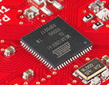
Flight Computer
ATmega128RFA1 microcontroller
Arduino compatible
16Mhz clock
128KB Flash
16KB SRAM
4096B EEPROM
2.4GHz radio (Compatible with Zigbee)

Slide 13
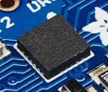
Inertial Measurement Unit
STMicro LSM9DS0
9-axis sensor
3-axis accelerometer
3-axis magnetometer
3-axis gyroscope
I2C interface (more on this later)

Slide 14
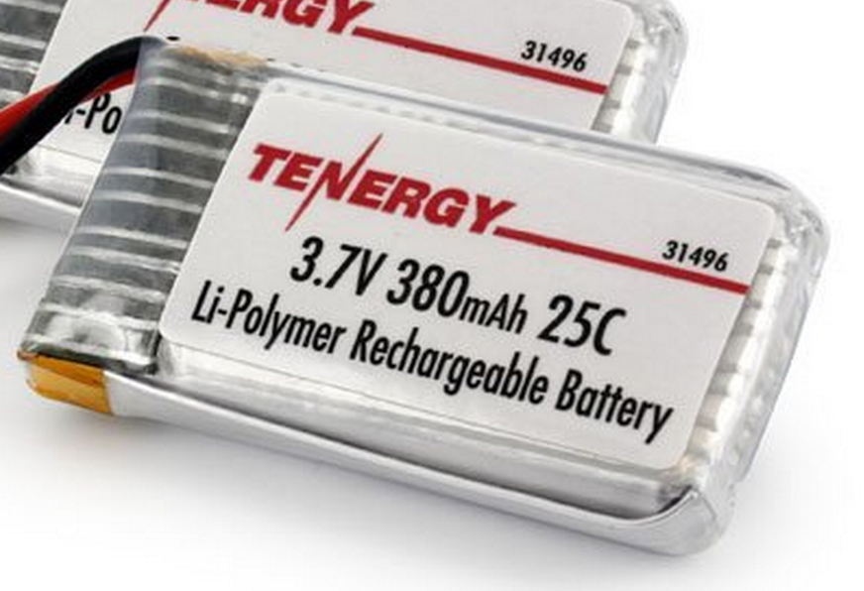
Power Supply
Lithium Polymer Battery
370 Mah
Max 9.25 Amps
Nominal voltage = 3.7V
Powers the motors directly
3.0V low dropout (LDO) voltage regulator
Powers the microcontroller and the IMU
Why 2.7 or 3V instead of 3.3V?

Slide 15
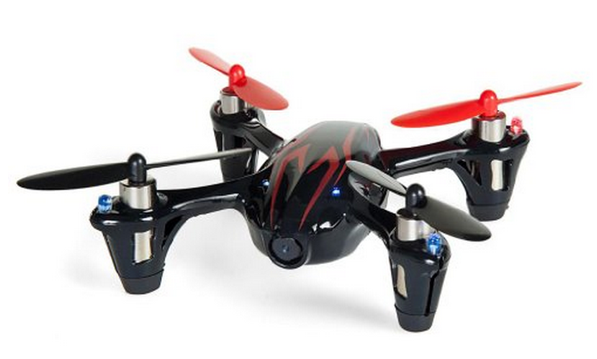
Motors and Props
Suitable motors are hard to find in small quantities.
Correct-fitting props are also a challenge
We will use motors for the Hubsan X4
Purchased as a “crash pack”
Plenty of power
DC brushed motors
They draw ~2A each.

Slide 16
Motor Driver
Pulse-width modulation (PWM)-controlled MOSFET
The microcontroller will drive the MOSFET
The MOSFET will drive current to the motor.
A diode handles the inductive load from motor when it’s off.

Slide 17
Wireless Communication
We will use a custom (i.e., designed by you) communication protocol between the controller an the quadcopter.
Why not one of the existing alternatives?
Standard RC radio protocols are analog or closed source.
Zigbee is complex and closed source.

Slide 18
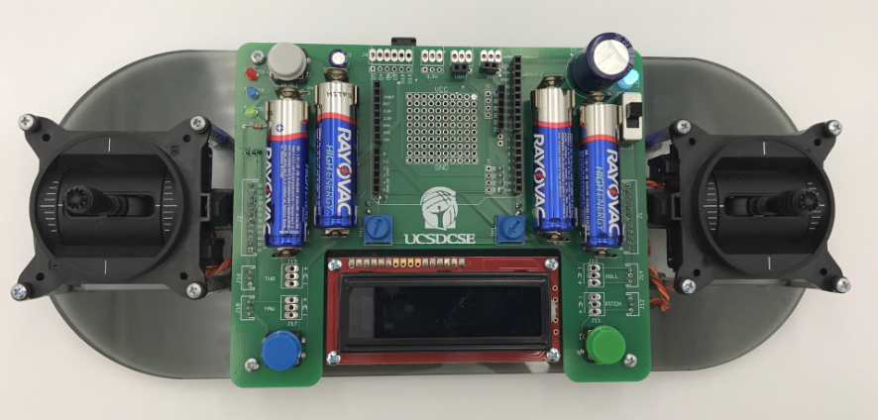
Controller
The controller sends commands to the quadcopter via the radio.
We have a controller design ready for you
It uses the same microcontroller we are using
You’ll be able to customize it a bit.

Slide 19
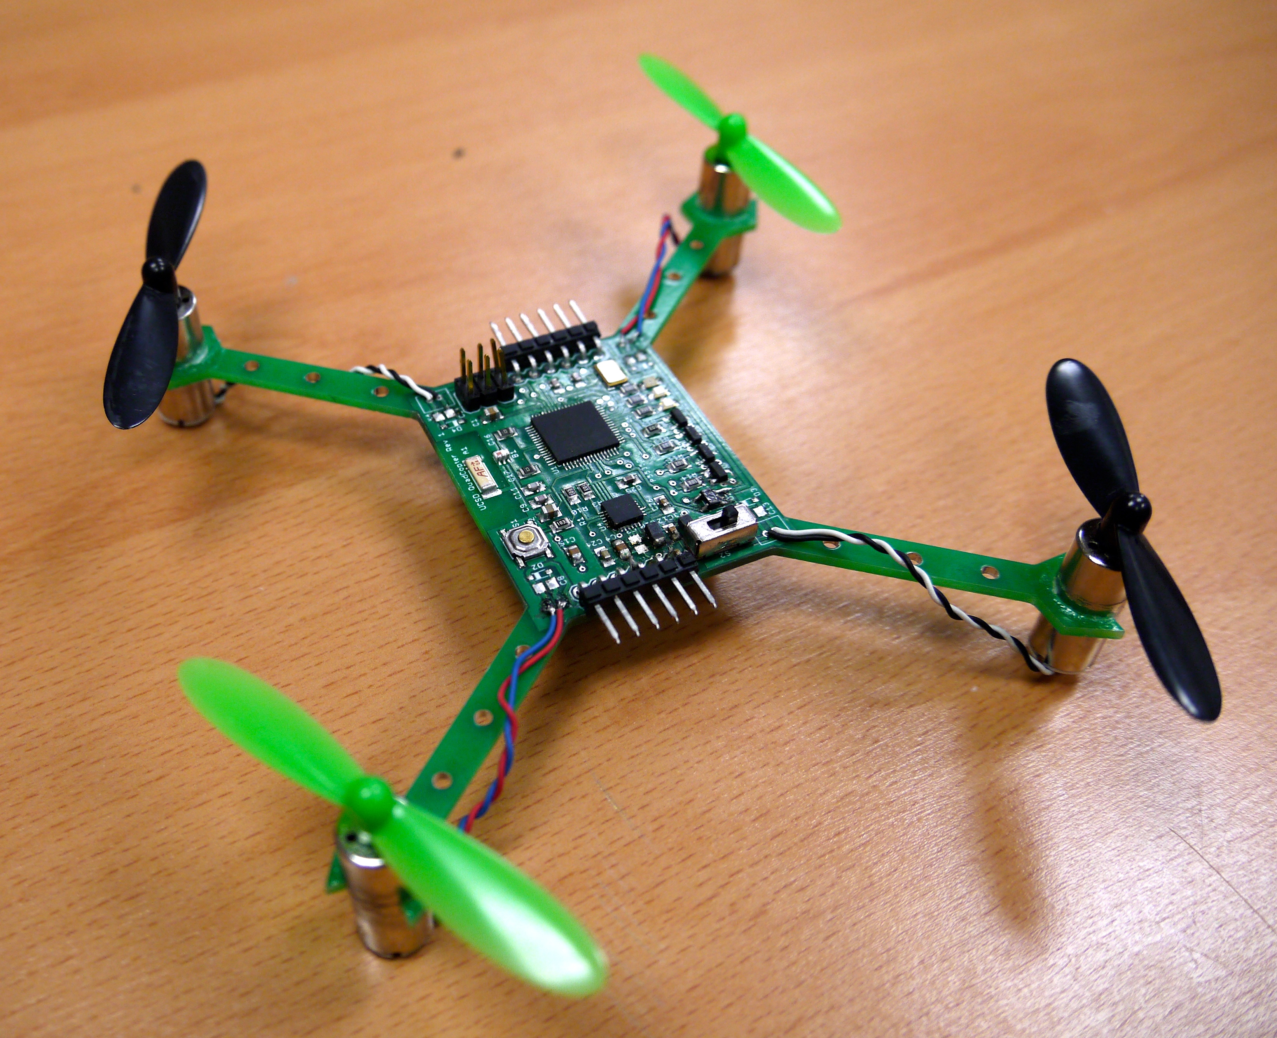
The Hardware You will Build

Slide 20
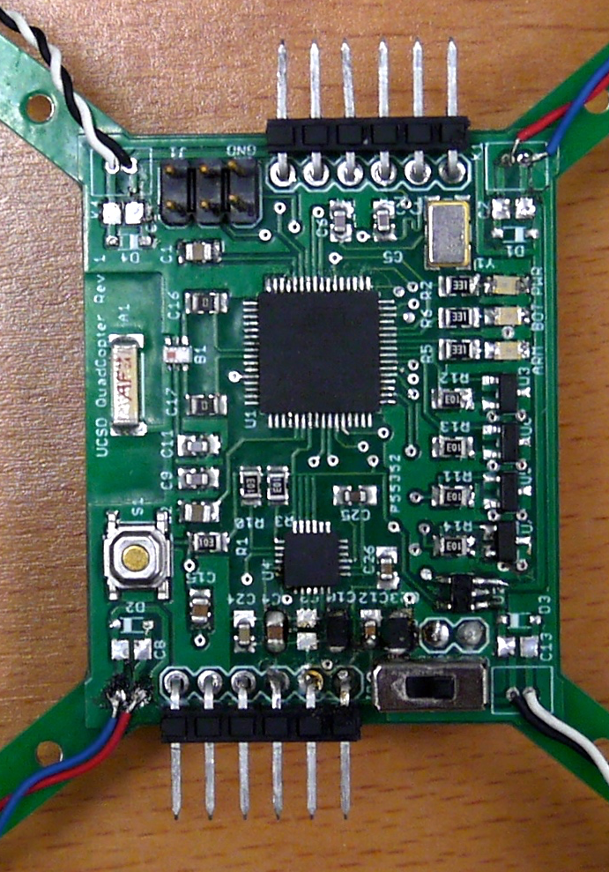
The Hardware You Will Build

Slide 21
The Software You will Build
Firmware for the remote
Measure inputs
Transmit them.
Flight control software for the quadcopter
Sense orientation
Maintain level flight
Respond to RC commands.

Slide 22
Lab 3: Make all Your Hardware Work a.k.a Remote Controlled Motors

Slide 23
Tasks
Meet the hardware
Get Arduino working
Read from the gimbals
Communicate with a radio
Assemble your test stand
Build 4 motor drivers
Wire everything up
Control your motors via the remote control.

Slide 24
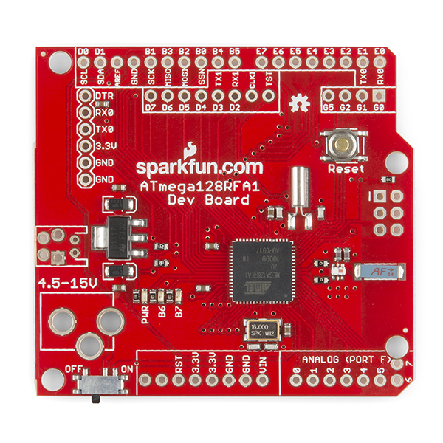
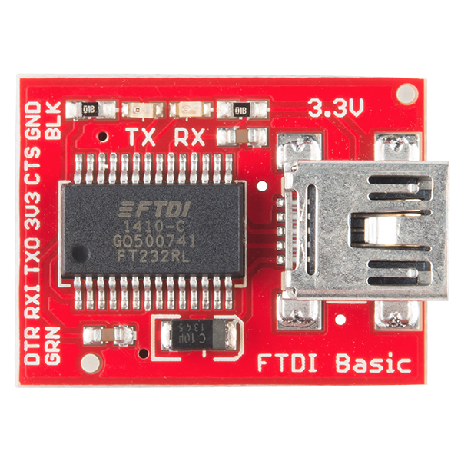
The “Red Board”
Nice breakout board for our microcontroller
Open source
Working radio design
Well-documented
Arduino compatible
Programmable with FTDI USB-to-serial converter
Key component of the controller
Reference design for the quadcopter’s flight computer and radio.

Slide 25
The Test Stand

Slide 26
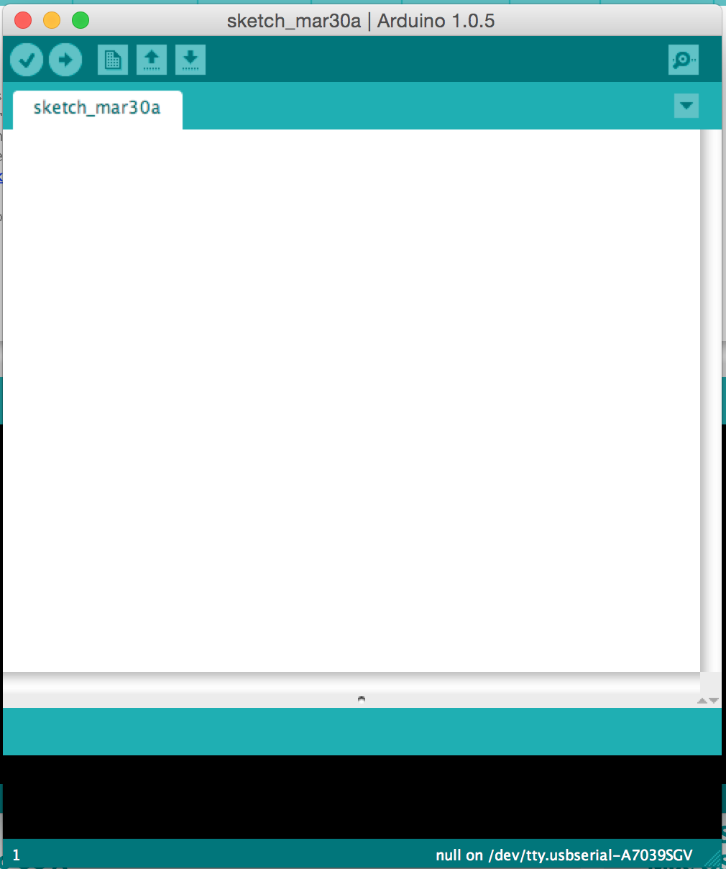
The Arduino IDE
User-friendly IDE for Arduino programming
Programming the microntroller is easy
Installation is easy
Alternatives
Eclipse for Arduino
Official AVR tools from Atmel
You can use them, but they aren’t supported by us.

Slide 27
The Inputs and Outputs
Gimbals – How they work and how to read them.
Brushed Motors – How they work and how to drive them.
The IMU – microcontroller and IMU communicate.
The serial display, LEDs, etc. – Communicating with the pilot.

Slide 28
Gimbals

Slide 29
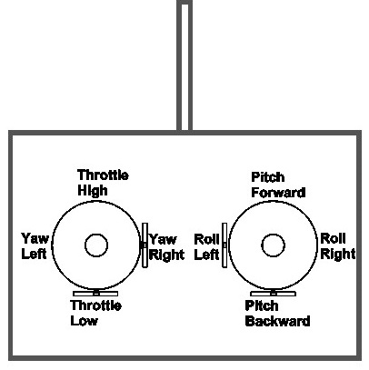
Controlling the Quadcopter
Standard RC “transmitters” have two sticks
Left: throttle and yaw
Right: pitch and roll
This is called “mode 2” It’s different in Europe where they use “mode 1”
Yaw, pitch, and roll are spring-loaded to return to neutral
Throttle stays where you put it.

Slide 30
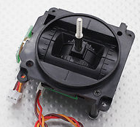
The Gimbals
Each stick is a “gimbal”
a mechanism, typically consisting of rings pivoted at right angles– The dictionary on my Mac

Slide 31
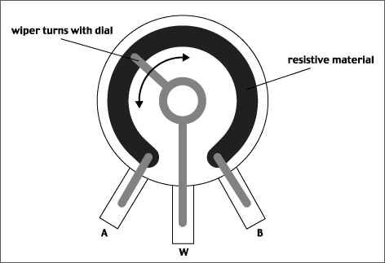
Anatomy of a Gimbal
Two potentiometers measure X and Y movement of the stick.
Potentiometer – A variable voltage divider
As the slider’s movement changes the resistance from A and W and W and B.
The voltage at W is proportional to the position of the gimbal.
In reality, the resistances are always > 0, so W never reaches VCC or GND.
Our gimbal
Frsky PR10
Total resistance: 2.4KOhms
Rated voltage: 5V

Slide 32
Reading the Gimbals
The red board board has several analog input pins
analogRead(int pin)
Takes a voltage between GND and Vcc and maps it to 0—1024
Check the schematic for the remote to see which pins are attached to which gimbals
https://github.com/NVSL/Quadcopter-Remote

Slide 33
Brushed DC Motors

Slide 34
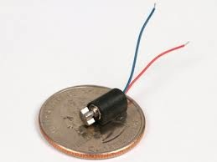
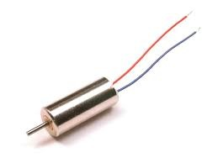
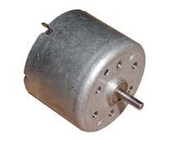
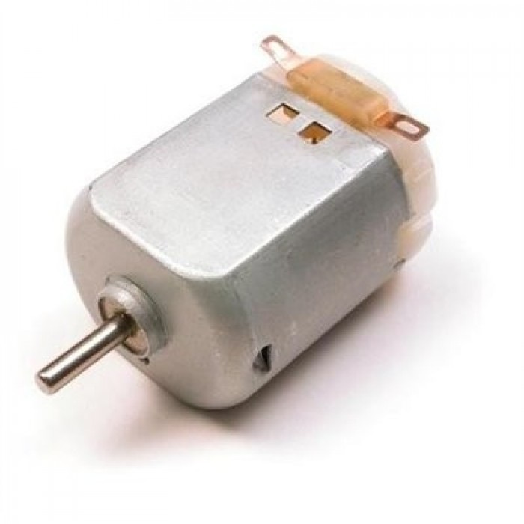
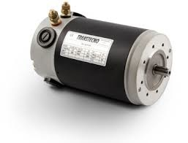
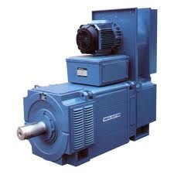
Brushed Motors

Slide 35
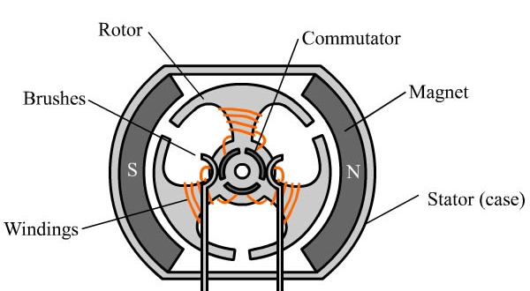
Construction

Slide 36
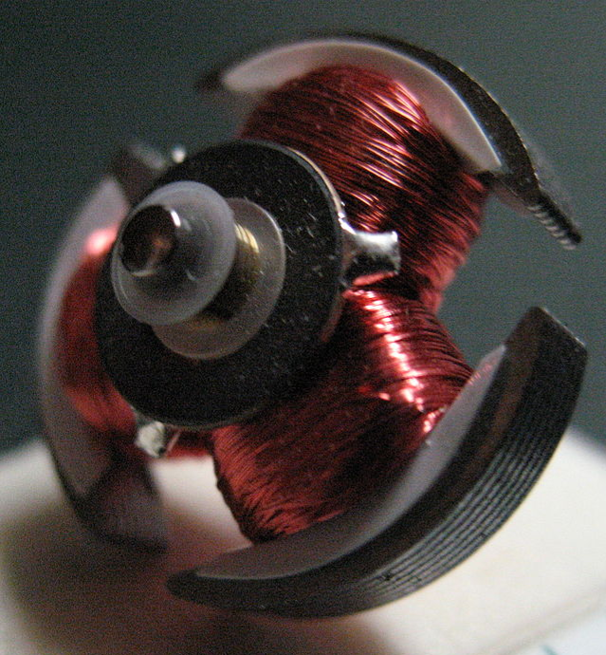
Construction (Rotor)

Slide 37
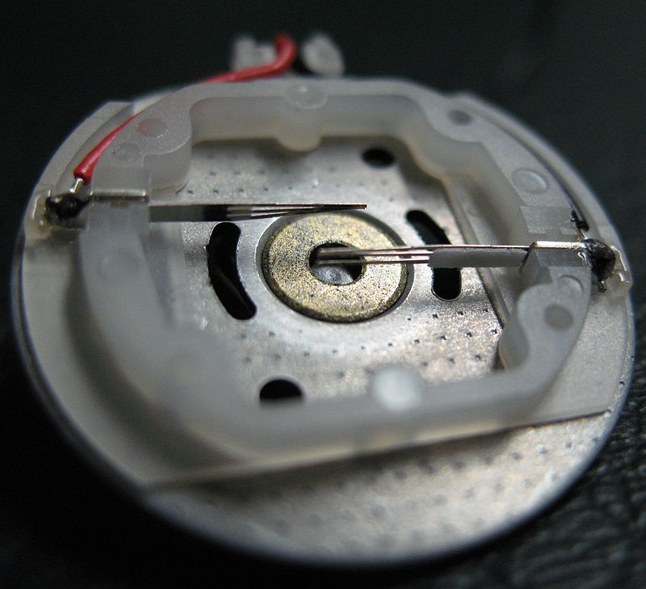
Construction (Stator)

Slide 38
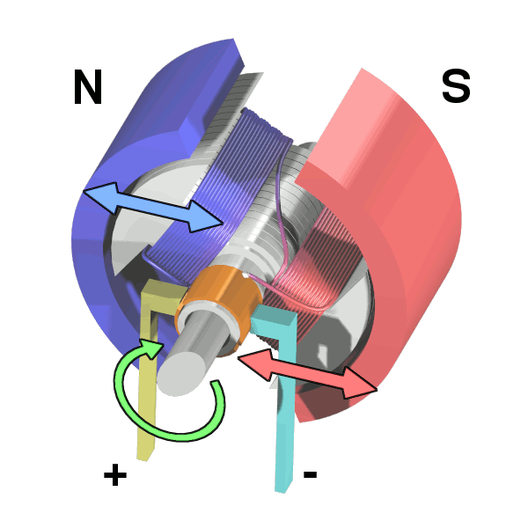
Operation

Slide 39
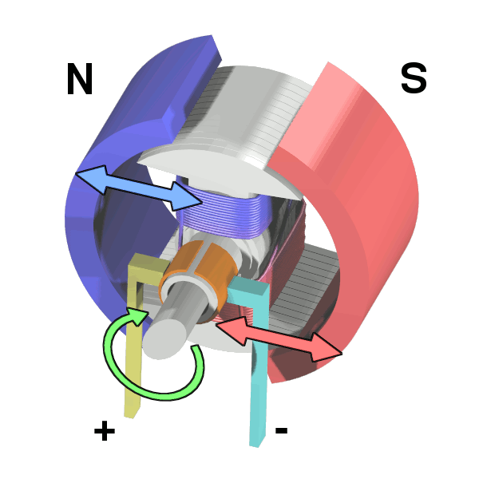
Operation

Slide 40
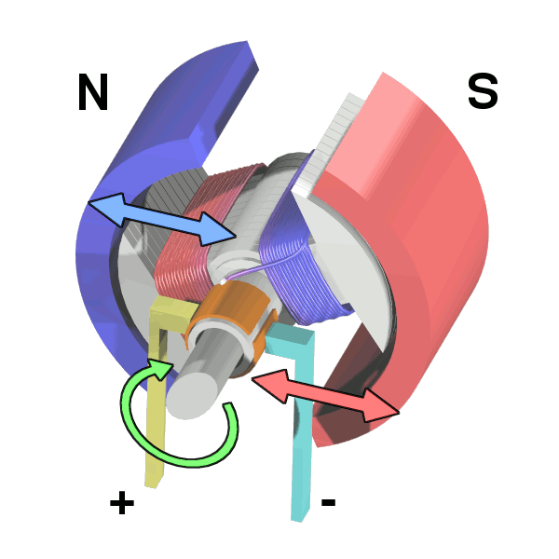
Operation

Slide 41
Operation

Slide 42
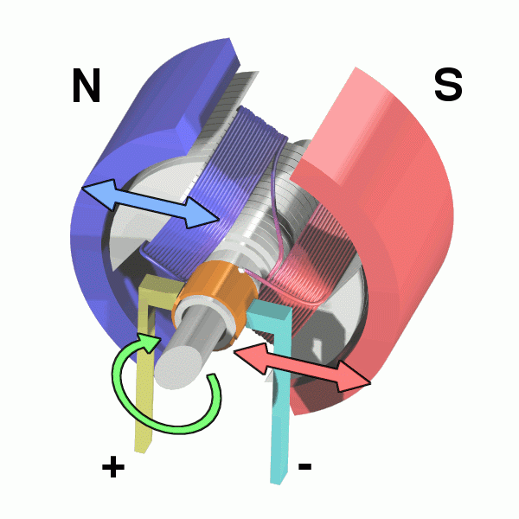
Operation

Slide 43
Flyback
Opening S1 makes M1 an inductor
Drives up voltage M1-
Can destroy the switch
Can cause current to back to power supply.
Causes noise on power supply.
This is called “fly back”
Adding a diode relieves the problem.

Slide 44
Control
How would you control your motor’s speed?
Speed ∝Voltage ∝Current
So, vary the input voltage
Generating varying voltages is non-trivial
You need an digital-to-analog converter
Really, we just need the average voltage to vary

Slide 45
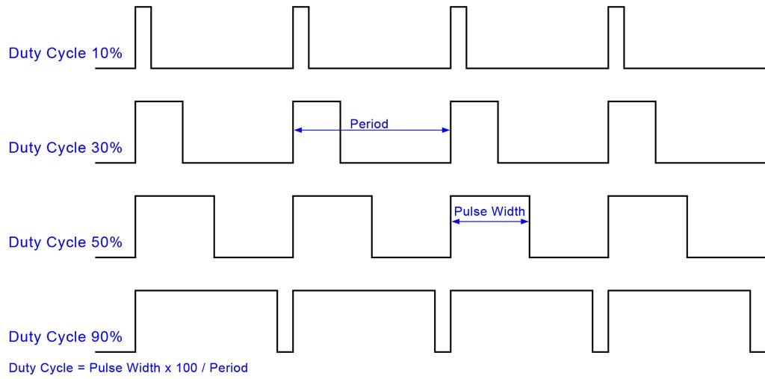
Pulse-width Modulation (PWM)

Slide 46
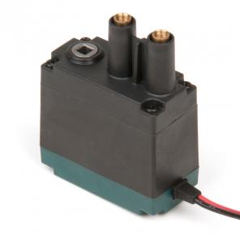
Selection
Free Speed:100 rpm
Stall Torque:8.6 in-lbs
Stall Current:2.6A
Free Current:0.18A
Specifications at 7.2V

Slide 47
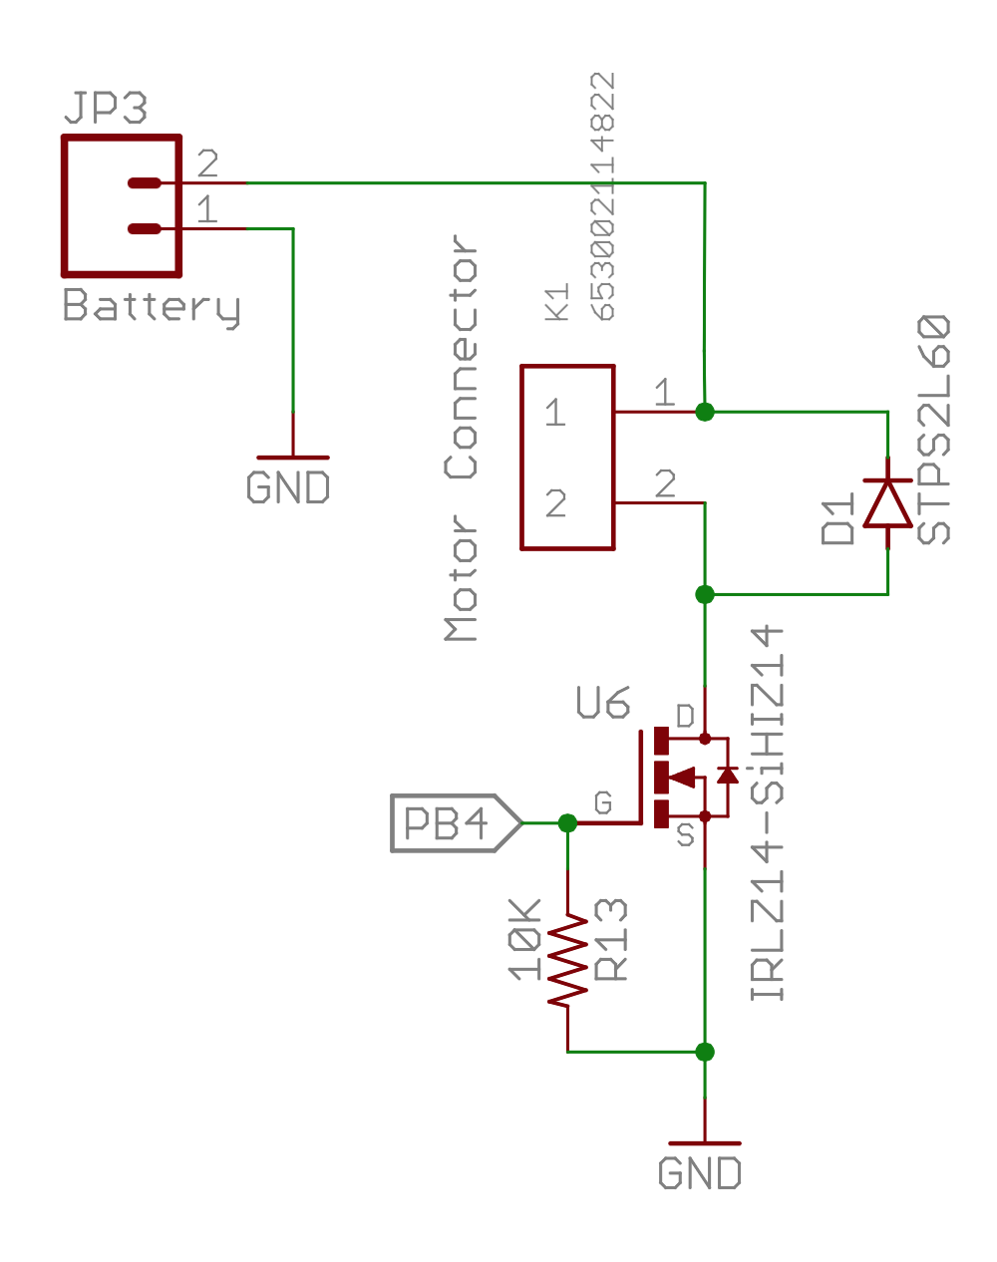
Our Motor Circuits

Slide 48
PWM in Arduino
The red board board has several analog output (PWM) pins
analogWrite (int pin)
Takes a value, x, between 0 (off) and 255 (on) and sets the duty cycle to x/255.

Slide 49
The Serial LCD Display

Slide 50
Display Text on the Remote
The LCD display on the remote is connected to the second serial port on the redboard
The LCD_library provides a nice interface for writing to it
Docs here: http://playground.arduino.cc/Code/SerLCD

Slide 51
Other Components

Slide 52
Status LEDs
The remote has 3 status LEDs (D3, D4, D5) in the upper left of the control board.
They are useful for letting you know when the quad is armed, etc.
Use digital_write() to control them.

Slide 53
Buttons
The remote has 2 buttons (B1, B2) for your use.
Use digital_read() to see if they are pressed.

Slide 54
Pots
The remote has 2 potentiometers (TM1, TM2)
Use analog_read() to get their value.

Slide 55
Lab Tasks
Use everything
Install IMU library. Read values from IMU.
Read the values from the gimbals.
Display things on the serial display.
Drive a motor.
Turn the indicators on and off.
Read values from the pots.
Use the buttons to do something
Build a remote-controlled motor
Stand alone red board drives motor.
Remote control reads gimbals and transmits value to run motor at.
This is the basic frame work for your quadcopter and remote firmware.

